Slide 1
International Economic Sanctions Modeling
Morad BALI, Natalia BOUROVA, Nady RAPELANORO

Slide 2
Introduction
Definitions
  Measures raised by a constitutional authorized entity, in order to constraints a target country to change his policies, in a way that they are not against international law anymore. Doxey (1971)
  A kind of coercive diplomatic measure that can be defined as the fact to inflict an economic pressure to a country, in order to demonstrate a will to protect predefined interests, while keeping the ability to start a military intervention if it is necessary. George, Hall, and Simons (1971)
Literature
  Doxey (1971): a pioneer, one of the first to have started econometric work on sanctions.
  Hufbauer, Schott, and Elliott (1990): a key reference as they studied one century of sanctions.
  Dreger, Fidrmuc, Kholodilin, and Ulbricht (2015): the first to introduce a sanction index to simulate sanctions.
Why a good sanctions index is important ? To simulate sanctions arrival, to avoid the use of dummy variables (less accurate), to use Vector Autoregressive models (VAR), to forecast.

Slide 3
Old Index
  Dreger, et al. (2015) created a sanction index with the following characteristics:
  A composite index with values of either :
    0 : no sanctions
    1 : against individuals
    2 : against specific entities
    3 : against an entire economic sector
  A weight depending of the trade relationship between the target and the sender. The stronger their relationship is, the higher the weight of sanctions will be.
  This index was extended and used more recently by Kholodilin and Netsunajev (2016).

Slide 4
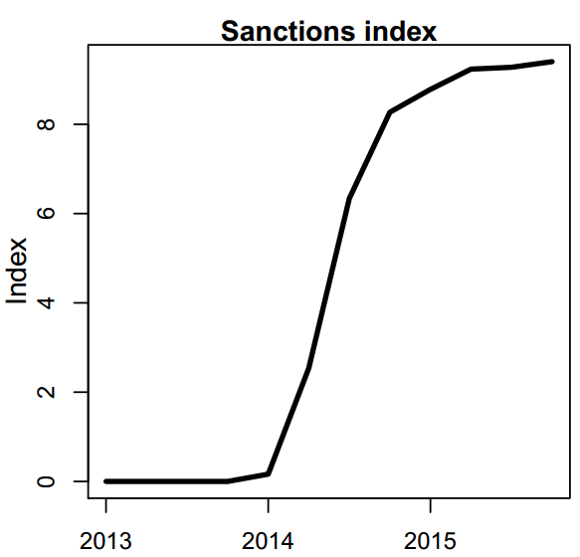
Old Index - Limitations
-Only three types of sanctions. That are not proportional : a sanction against an entire sector is only three times stronger than a sanction against one individual !
-It grows with the arrival of new sanctions, but can’t decrease :
It means that sanctions decided in 2014, will still have the same effects in 2018.
-Sanctions are not treated independently from each other : impossible to know if the effects are due to American or European sanctions, for example
-Index is quarterly only.
Kholodilin and
Netsunajev (2016)

Slide 5
New Sanction Index
Still a composite index, but more developed.
Each sanction has its own ID, including :
  Sender country : which country set up this sanction ?
  The initial value determined by :
  Type of sanction : announcement, against individual, company, sectors.
  Three coefficients affecting its value
  Time factor : gathers all inexplicable factors that have a negative effect on the economic pressure induced by punitive measures.
  Economic leverage : the ability of the sender to apply economic pressure on the target (if the country doesn’t trade at all with the target, the leverage is nil.
  Third country effect : the presence of a third country, helping the target to avoid sanctions.

Slide 6

New Sanction Index

Slide 7
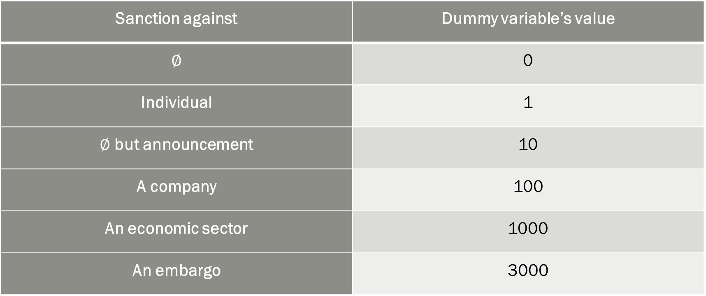
New Sanction Index
Initial value, depending on the type of sanction :
Sanction against | Dummy variable’s value
 | 0
Individual | 1
 | 10
A company | 100
An economic sector | 1000
An embargo | 3000

Slide 8
New Sanction Index
-The Index is monthly and can be turned in quarterly.
-Each sanction is independent and can be modified without influencing others.
-Sanctions ability to create economic pressure decrease over time.
- Sanctions types and
attributed values are more realistic. Even though it remains an heuristic.

Slide 9
Results improvements - illustration
With the OLD Index
With the New Index
Two Structural VAR models, built in the same way. The only variable that differs is the sanction index.
The Confidence Interval is tightened with the new index : results are statistically more significant.
Better explanatory power: on the left we can explain 0.7% of the variation of our interest variable,
while on the right –with the new index- we can explain 4.8%.

Slide 10
Thank you for your attention
  Don’t hesitate to contact us if you have precise questions, or if you wish to have access to our sanction index.
  Bali, M. : PhD student and Researcher in International Economics. Theorist of the New Sanction Index. moradbalifr@gmail.com
  Bourova, N. : Professor and Researcher – Director of the French-Russian Center for Educational and Scientific Cooperation of SPbGEU. Research Supervisor.nbourova@mail.ru
  Rapelanoro, N. Doctor in Economics and Researcher in Econometrics. Main Econometrician. nady.rapelanoro@gmail.com

