Slide 1
Imagined Democracy: a quantitative analysis of political discourses
Theodore Chadjipadelis
Aristotle University of Thessaloniki
chadji@polsci.auth.gr

Slide 2
Abstract I
Recent events suggest the devaluation of representative democracy and the concomitant rise of populism. We examine this phenomenon, comparatively, by a quantitative analysis of perceptions of “democracy” amongst three samples of university students (Greek, Irish and Russian) using a questionnaire constructed for this purpose.

Slide 3
Abstract II
Our analysis of political attitudes is based on the assumption that next to a rational-choice utilitarian process which guides us in matters of party preference and voting behavior, lays a less-than-rational cognitive process of moral decisions which is based on definite notions of good and evil. In this vein we adopt a phenomenological perspective and argue that the self is not prior to morality, but, instead, that: (1) the self is constituted in and through the taking of moral stances informed by “constitutive goods”(Taylor, 1989) that emerge out of, and are embedded in, civilizational, cosmological and ontological principles;(Eisenstat, 1995) and (2) the binary oppositions that constitute these moral imperatives and ethical ways of life can be retrieved by quantitative analysis,(Alexander & Smith, 1993) allowing us to reconstruct the symbolic patterns that reflect these moral principles in social action and structures.

Slide 4
Abstract III
We regard these moral principles to be analytic components of social relations of power that penetrate the latter through “discourses” (Alexander & Colomy, 1985). Discourses constitute the backbone of the political sphere and encapsulate moral imperatives that are mobilized by various elites and social groups in their struggle for political supremacy and privileged access to resources. (Fairclough, 1995) These discourses could be informed by different moral imperatives due to (a) the multiplicity of moral goods that, to use Eisenstadt’s terminology, “float free” in a given society,(Eisenstat, 1963) or, as our analysis reveals, (b) by the emergence of alternative and distinct moral variations that are produced out of the same moral universe by a process of selective affinity.

Slide 5
Abstract IV
We structured these discourses around two analytically opposing perceptions of democracy: the emotive-populist and the rational-bureaucratic. Based on this bipolarity, we analyze perception of democracy around the binary juxtaposition of emotive-populist understanding of democracy as intimacy and struggle, and sober-bureaucratic understanding of democracy as rules and regulations. Methodologically, we juxtaposed populism vs. rationalism in two sets of statements representing notions of (a) the “democratic self”, (b) of “democratic relations,” and then we placed these preferences on a matrix made of the samples’ responses to statements concerning emotive-populist and rational-bureaucratic aspects of “democratic institutions.” The tables that emerged out of this analysis allowed us to examine the moral imperatives that animate emotive-populist and rational-bureaucratic notions of Democracy and understand the underlying imagery of political discourses.

Slide 6
Abstract V
In detail, expressing each item by a binary variable, we clustered subjects according to their positions towards each group using hierarchical cluster analysis method. The resulting variable representing cluster membership was used together with the binary variables in a multivariate correspondence analysis setup using BURT table. By this method we come up with compact groups of subjects describing a typology of individuals (i.e. the synthetic variable representing cluster membership). Finally, by the multivariate analysis we come up with specific definitions of discourses.

Slide 7
Abstract VI
This analysis allowed us to capture visually these discourses in the form of “semantic maps.” These maps bring together the binary elements of the political discourses the “democratic self”, the “democratic relations”, and the “democratic institutions” are made of, and allow us to visualize their complex combinations as they are laid out in the public sphere and reflected in the minds of our samples. In effect, the semantic maps capture the selective affinity between various political signifiers of good and evil, and the ways “democracy” is interpreted differently in the three samples due to the different ways binary statements are interlinked and made meaningful in different symbolic classifications.

Slide 8
Abstract VII
This part of the study examines the process by which actual individuals construct their personal symbolic universe from elementary combinations of binary oppositions to complex discourses of the good and of the evil political society. Our methodology is inspired by Alexander and Smith’s (1993) discursive analysis of American civil-democratic political narratives, an analysis which we have elaborated and turned into a quantitative comparative model to examine the political culture. It is conceptualized as to capture the full process of building up a symbolic order of a democratic society, in a bottom-up way: from the elementary to the complex, and from the immediate to the societal and the institutional. It allows us to examine the phenomenological process by which individuals, by analogy and homology construct symbolic representations of (a) themselves as ‘democratic citizens’ (b) ‘democratic relations’, and (c) ‘democratic institutions’.

Slide 12
Methods
A composite index of ‘populism-Civil-Liberal’ was constructed, taking into account only those who scored 3+ and 3- in the above set of questions.
We count as + the selection of a ‘rational’ statement as democratic or the selection of a “collectivist” statement as non-democratic. Also, we count as - the selection of a “rational” statement as non-democratic or the selection of a “collectivist” statement as democratic.
The index runs from [-6: ‘collectivism’] to [6: ‘civil-liberal’].

Slide 13
Data Analysis I
Data analysis was based on Hierarchical Cluster Analysis (HCA) and Multiple Correspondence Analysis (MCA) in two steps (Chadjipadelis, 2015). In the first step, HCA was used to assign subjects to distinct groups according to their response patterns. The main output of HCA was a group or cluster membership variable, which reflects the partitioning of the subjects into groups. Furthermore, for each group, the contribution of each question (variable) to the group formation was investigated, in order to reveal a typology of behavioural patterns.

Slide 14
Data Analysis II
In the second step, the group membership variable, obtained from the first step, was jointly analyzed with the existing variables via Multiple Correspondence Analysis (MCA) on the so-called Burt table (Greenacre, 2007). The Burt table is a symmetric, generalized contingency table, which cross-tabulates all variables against each other. The main MCA output is a set of orthogonal axes or dimensions, that summarize the associations between variable categories into a space of lower dimensionality, with the least possible loss of the original information contained in the Burt table. HCA is then applied on the coordinates of variable categories on the factorial axes. Note that this is now a clustering of the variables (the categories of the variables), instead of the subjects. The groups of variable categories can reveal complex discourses. Bringing the two analyses together, behavioral patterns and complex discourses are used to construct a semantic map for the variables and the subjects.

Slide 15
Data Analysis III
Using CAH we get a grouping variable for each set of variables [Ε16Α, Ε17], [Ε16Β, Ε17], [Ε18Α, Ε19], [Ε18Β, Ε19]. Next, we jointly analyze the grouping variables for the set of variables {[Ε16A, E17], [Ε16Β, Ε17] and E17} by Multidimensional Correspondence Analysis. The same analysis was used and for the grouping variables for the set {[Ε18Α, E19], [Ε18Β, Ε19] and E19}.

Slide 16
Data Analysis IV
Finally, an index variable was computed from the data of variables Ε20. The index variable was recoded into 3 categories and jointly analyzed with the grouping variables for E16A, E16B, E18A, E18B via Multidimensional Correspondence Analysis and consequently by Cluster Analysis.
Following this methodology, we can detect ways the individual perceives itself and the public sphere in moral terms, that is, in terms of good and evil, and just and the unjust. We argue that the political sphere, and to a large extent the public sphere, is to be explained not in terms of ideological preferences, but primarily as a culture that is prior to ideology and affects the ways ideological and political programs are perceived and implemented.

Slide 17
Greece (~900 questionnaires) forthcoming
Palgrave McMillan “The Greek Crisis and its Cultural Origins:
A Study in the Theory of Multiple Modernities”

Slide 18
Semantic map
The first pattern provides us with the six geometric figures (see figure below) which represent six groups of variables which define six discrete groups of individuals.
The content of each one of these six groups is defined by the binary items which are connected directly and explicitly to the levels of the grouping variables which (grouping variables) derive from the second step of the analysis and are included (the levels of the grouping variables) in each one of the groups. Thus, each group is represented by a geometrical figure on the map. The binary items connected to each figure are written in non-italics.

Slide 19
Semantic Map
The second pattern provides us with the discourses these groups of individuals use to describe the democratic self, the democratic relations, and the democratic institutions. To arrive at these discourses we first identified eight groups of individuals. Each group of individuals is connected to a level of collectivist-rational variable (E20). The same group is also connected to some binary items which are connected directly and explicitly to the levels of the grouping which (grouping variables) derive from the second step of the analysis and are included (the levels of the grouping variables) in each one of the groups.

Slide 20
Semantic map
The binary items which are connected to each one of these groups of individuals constitute the discourse of the level of collectivist-rational variable which is connected with the same group. These binary items are written in italics.
Thus, by describing the six groups of the second step we define the specific characteristic of each one of the six groups by using the grouping variables of 16A, 16B, 18A, and 18B, and by connecting the eight groups from the first step of III.7 with the collectivist-rationalist variable levels, we reveal the abstract discourse for the responding level of the collectivist-rationalist variable.

Slide 21
Semantic map
The map presents the full spatial distribution of the binary features/items of the democratic self and the democratic relations vis-à-vis democratic institutions. Accordingly, each institutional framework (Civil-liberal and Populist-communitarian) concentrates two types of items:
The first type (colored and in italics) is the items used in discourses “oriented” toward a particular institutional framework (Populist, Civil-liberal, Intermediate). Its location inside a given discourse is not exclusive, since the same item could be used in the context of another institutional framework as well (e.g., the item ‘victim – offender’ is used by all three discourses, the item ‘realistic – unrealistic’ by two, while the item ‘straightforward – calculating’ only by one).

Slide 22
Semantic map
The second type of items (not in italics) is the one that is exclusively located inside a particular institutional framework and is not found anywhere else. The analysis suggests that a given discourse is made of and is constructed around two types of symbols: the core and the peripheral. In other words, particular political visions of the good (in our case, of democratic institutions), could appropriate and make use of symbols floating in the public sphere and common to many competing discourses. These symbols are expendable, in that they will be triggered according to the occasion, to be dropped on other occasions when other symbols become contextually useful. But there is a limit to this flexibility, imposed by the presence of some symbols which are indispensable since they constitute the core of the discourse.

Slide 23
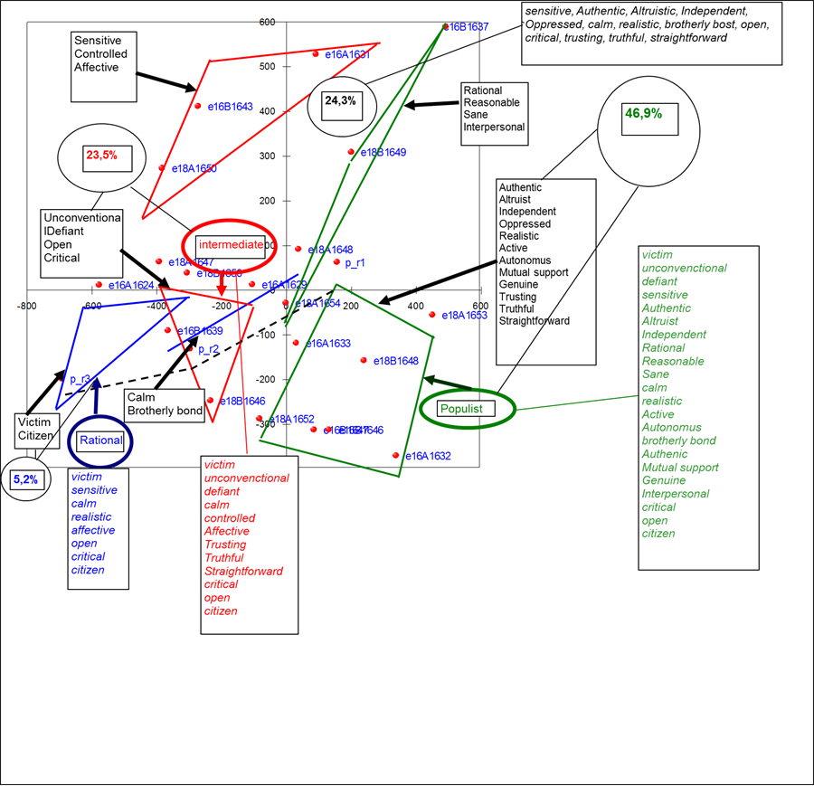

Slide 24
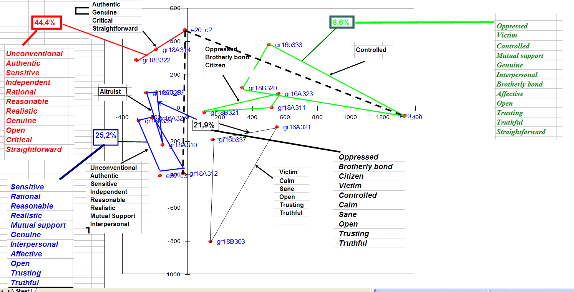

Slide 25
Irish vision of democratic institutions
16A | 16B | 18A | 18B
16A323-A v. Oppressed-Oppressor | 16B333-A v. Controlled-Excitable | 18A311 (Civic egalitarianism) v. Brotherly bond-Stranger | 18B321 vi. Citizen-Enemy 18B320 (parrhesia) ii. Trusting-Suspicious v. Straightforward-Calculating | R.
 |  | 18A314 Romantic i. Authentic-Hypocritical iii. Genuine-Manipulative | 18B322 (Outspokenness) i. Open-Secret iii. Critical-Deferential v. Straightforward-Calculating C | I.
16A327-B Autonomous i. Unconventional-Conventional iii. Authentic-Hypocrite vii. Sensitive-Calculative viii. Independent-Dependent | 16B336-B Cerebral iii. Rational-Irrational iv. Reasonable-Hysterical vii. Realistic-Unrealistic | 18A312-B (Communal) ii. Mutual Support-Egoist iii. Genuine-Manipulative iv. Interpersonal-Mediated vi. Affective-Formal |  | P.
16A328 vii. Sensitive-Calculative |  | 18A310 (Communal) ii. Mutual Support-Egotist iv. Interpersonal Mediated vi. Affective-Formal |  | N.
16A321 vi. Victim-Offender | 16B337 vi. Calm-Passionate viii. Sane-Mad |  | 18B303 i. Open-Secret ii. Trusting-Suspicious iv. Truthful-Deceitful | O.

Slide 26
Russia (~170)

Slide 27
Peter Meylakhs, Ph.D.,
Associate Professor
Laboratory for Comparative Social Research
Senior Research Fellow
Higher School of Economics, St. Petersburg, Russia
tel. +7(921)9410111
http://lcsr.hse.ru/

Slide 28
