Slide 1
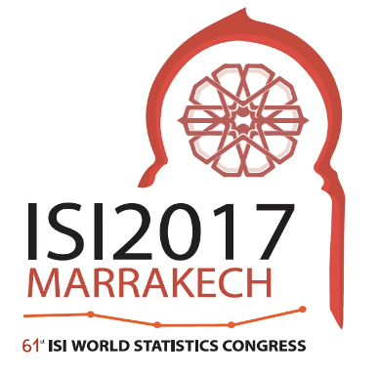
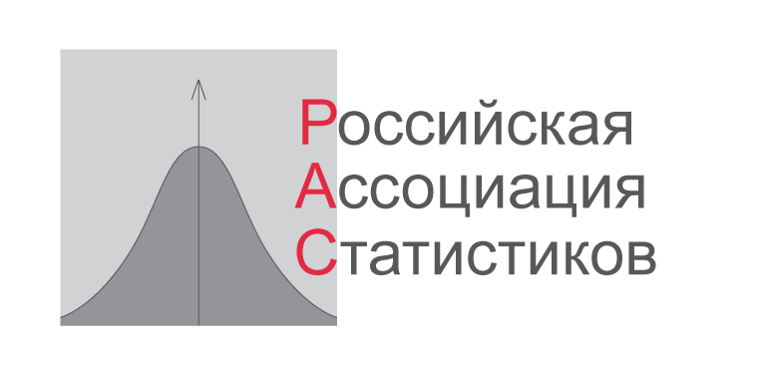
The first results of ODIN.Russia
Alexey Ponomarenko
Russian Association of Statisticians
July, 18, 2017

Slide 2
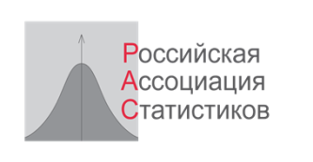
The first results of ODIN.Russia
Marrakesh, July 18, 2017
About the Project.
The Open Data Inventory – Russia (ODIN.Russia ) provides an assessment of the breadth of coverage and openness of of official statistics
Conducted by
Russian Association of Statisticians (RASt)
Partner project:
The Open Data Inventory (ODIN)
Partner organization:
Open Data Watch (ODW)

Slide 3
The first results of ODIN.Russia
Marrakesh, July 18, 2017
How it works:
Volunteers examine the site of the statistical agency and assess the availability, aggregation level and format of the standard set of the most demanded statistical indicators.
Set includes about 50 indicators grouped to three categories:
Social statistics
Economic and financial statistics
Environment statistics
Assessment criteria evaluate the topical, temporal, and geographic coverage. Criteria for openness are based on the Open Definition.

Slide 4
The first results of ODIN.Russia
Marrakesh, July 18, 2017
RASt/ODW cooperation:
Methodology is practically the same (general approaches, assessment rules, set of indicators, criteria).
Timing is coordinated
Training, consultations and cross-checking the results
Differences:
ODW investigates only the web-site of the national statistical office and few sites of agencies directly linked to it are examined.
RASt surveys sites of all agencies of NSS to rank agencies involved in statistics.
In perspective, RASt will survey also regional statistics to rank Russian regions

Slide 5
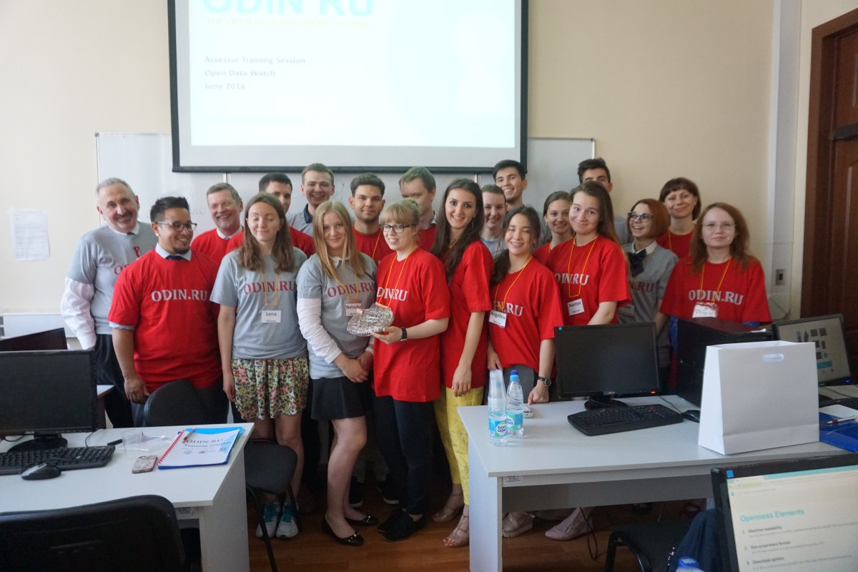
The first results of ODIN.Russia
Marrakesh, July 18, 2017
Training in Moscow:
Volunteers from Moscow,
Sankt-Petersburg, Novosibirsk
and other Russian regions
as well as from Armenia and
Belorussia
Teachers from ODW and RASt
June 2016

Slide 6
The first results of ODIN.Russia
Marrakesh, July 18, 2017
ODIN.Russia 2016 results, coordinated with IDIN2016
Eastern Europe: 6 of 10
(6 in coverage and 6 in openness)
World: 38 of 173
(23 in coverage and 45 in openness)
Categories | Coverage and aggregation | Openness | Total
Social statistics | 43 | 39 | 41
Economics and finance statistics | 70 | 60 | 65
Environment Statistics | 62 | 52 | 57
Total | 57 | 52 | 54

Slide 7
The first results of ODIN.Russia
Marrakesh, July 18, 2017

Slide 8
The first results of ODIN.Russia
Marrakesh, July 18, 2017
General results looks quite successful for the Russian official statistics:
Russian 38 rank is typical for Eastern Europe and higher than the Japan (43) British (46), French (53) ranks
BUT
there are “birthmarks” of Soviet Statistics:
More attention to economics rather then social indicators
Orientation to government (official style)
Little attention to licenses, terms of use, etc.
We call this effect “statistics-in-itself”

Slide 9
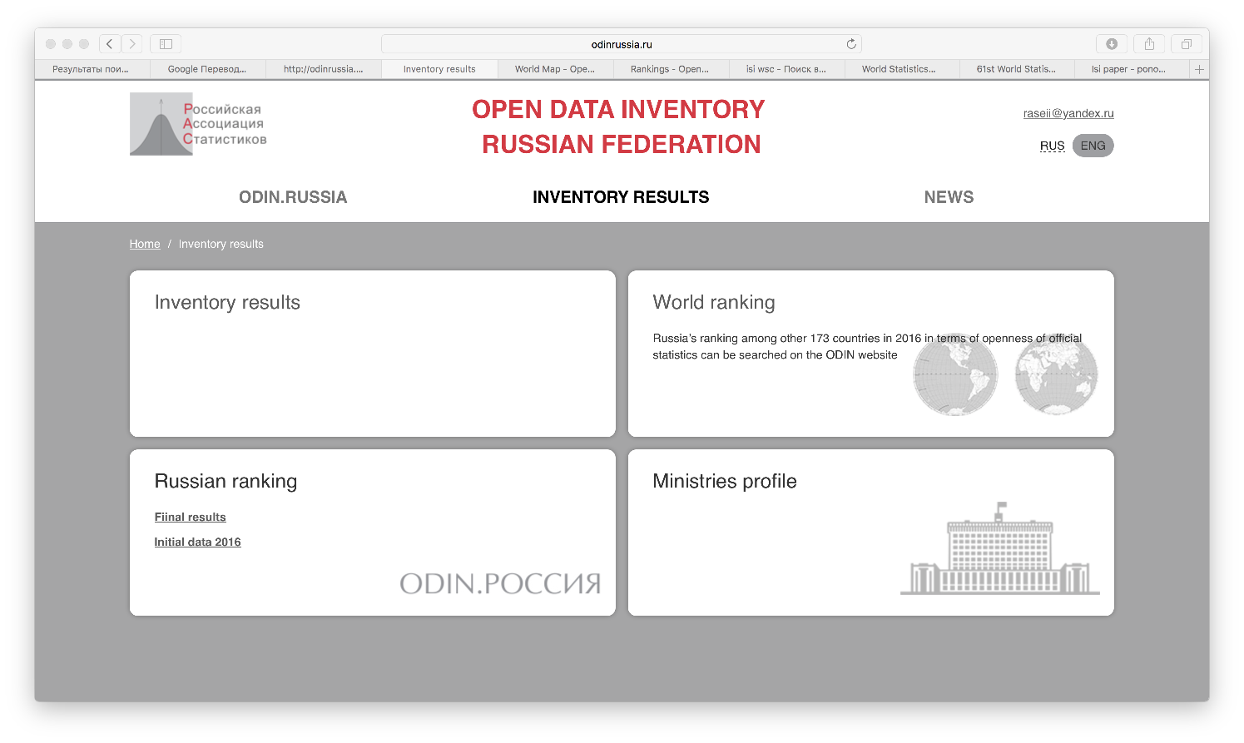
The first results of ODIN.Russia
Marrakesh, July 18, 2017

Slide 10
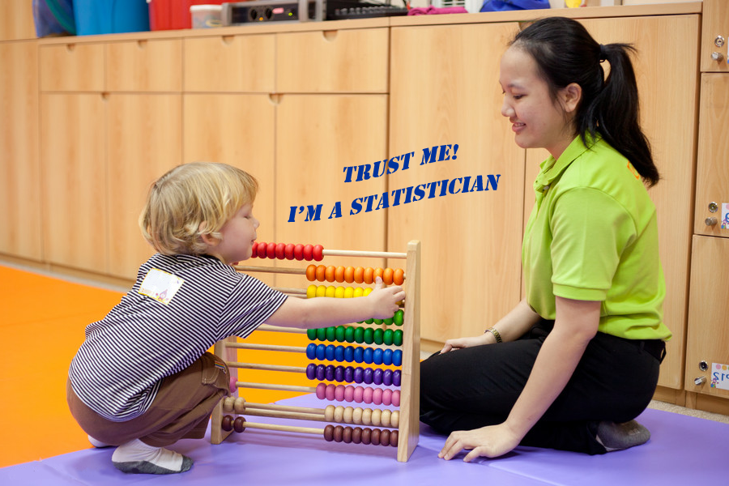
The first results of ODIN.Russia
Marrakesh, July 18, 2017
СПАСИБО!
THANK YOU!
ODINRUSSIA.RU
RUSASSTAT.RU
ponomarenko26212@gmail.com

